Slide 1
.
WELCOME
.

Slide 2


.
.
Rayat Shikshan Sanstha’s
“Karmaveer Bhaurao Patil College of
Engineering, Satara”
Computer Engineering Department
Academic Year: 2024-25
Project Name:
“Math With Gesture Using AI(LMS)”

Slide 3
PROJECT TITLE :- “MATH WITH GESTURE USING AI(LMS)”
UNDER THE GUIDANCE OF PROF MR. BHAGWAT SHANKAR UCHALE
GROUP MEMBERS
1. JAY SUDHIR KADU (ROLL NO :- 47)
2. MOHIT NITIN HOL (ROLL NO :- 31)
3. GANESH SHIVAJI JADHAV(ROLL N0 :-34)
4. VISHWAJEET DEEPAK KADAM (ROLL N0 :-45)

Slide 4
CONTENT
INTRODUCTION TO MATHS WITH GESTURE USING AI (LMS)
PROCESS OF PROJECT
LITERATURE SURVEY
EXISTING SYSTEMS
OBJECTIVES
PROPOSED SYSTEM
SYSTEM ARCHITECTURE DIAGRAM
WORK FLOW
APPLICATION DESIGN
ADVANTAGES
LIMITATIOND
FUTURE SCOPE
CONCLUSION
REFERANCES

Slide 5
Motivation(case study)
Case Study:
Enhancing Math Learning with AI-Driven Gestures in LMS Problem:Traditional LMS platforms lack interactive tools for kinesthetic learners.Math concepts, especially abstract ones, are hard to grasp using only text or static visuals.
Integrate AI-driven gesture recognition into LMS, allowing students to interact with math through physical gestures (e.g., drawing shapes or solving equations).AI recognizes and provides feedback in real time, enhancing engagement and understanding.

Slide 6

Introduction to Maths with Gesture using AI (LMS)
This presentation explores a novel Learning Management System (LMS) that utilizes Artificial Intelligence (AI) to enhance mathematics education through gesture recognition. This system aims to bridge the gap between traditional learning methods and modern technology, providing an intuitive and engaging learning experience for students.

Slide 7
Literature Survey
Mat Journals research and reviews machine learning ISSN :2583-4835 Mat Journals Development in Al ISSN :0976-5832
International Journal of Creative Research Thought 2020 IJCRT | Volume 8, Issue 6 June 2020 | ISSN: 2320-2882
Current systems that integrate mathematics with gesture recognition using AI combine gesture capturing technology with advanced AI algorithms to enhance mathematical interactions.
International Journal of e-Education e-Business e-Management and e-Learning · January 2013 DOI: 10.7763/IJEEEE.2013.V3.233
Existing Learning Management Systems (LMS) are centralized platforms that manage and deliver educational content, offering features like course creation, user management, assessments, and communication tools.
Journal of Social Studies Education Research 2022: 13 (2), 147-169 https://sdxlturbo.ai/blog-math-with-gestures-using-ai-45425

Slide 8
Existing Systems
Math with Gestures Using AI :-
The existing systems for learning and practicing mathematics are predominantly traditional, relying heavily on textbooks, whiteboards, and digital tools such as calculators or basic educational software. While there are some interactive learning platforms and educational apps, they typically require manual input through keyboards or touchscreens. These systems do not effectively leverage the potential of modern technologies like gesture recognition or artificial intelligence.
Existing System:- Apple ipad calculator
Apple introduced a similar feature in their iPad calculator at the latest WWDC.

Slide 9
Learning Management System (LMS)
The existing Learning Management Systems (LMS) widely used today are functional but come with significant limitations that affect both educators and students. Rigid Structure: Traditional LMS platforms often have a one-size-fits-all approach, lacking the flexibility to adapt to different teaching styles or student needs.
Existing System:- Udemy, Akash , Unacademy, Java tpoint.

Slide 10
Objectives
Develop a gesture-based LMS :- Create an intuitive and engaging LMS that utilizes gesture recognition for interactive mathematics learning.
Enhance Student Engagement :- Promote active participation and deeper understanding by allowing students to directly interact with mathematical concepts.
Personalize Learning Experiences:- Tailor the learning content and pace to individual student needs and learning styles.
Improve Learning Outcomes:- Increase student comprehension, retention, and problem-solving skills in mathematics through interactive and engaging learning.

Slide 11
Proposed System
There is a lack of interactive tools that engage students and make learning more intuitive and fun. In particular, students with disabilities or those who struggle with traditional learning methods may find it challenging to grasp mathematical concepts. There is a need for an innovative solution that utilizes AI and gesture recognition technology to create an interactive and engaging learning environment for mathematics. Learning Management Systems (LMS) often lack personalization, engagement, and adaptability to individual learning styles. These systems are not fully optimized to provide a seamless experience for both students and educators, leading to challenges in content delivery, performance tracking, and engagement.

Slide 12
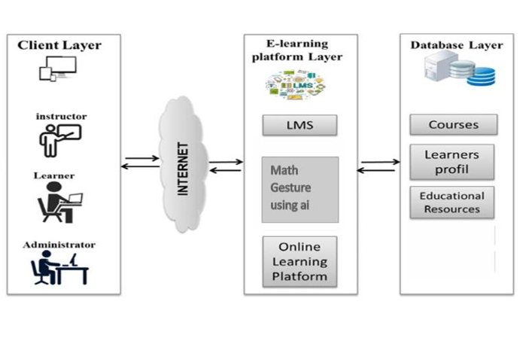
System Architecture Diagram

Slide 13
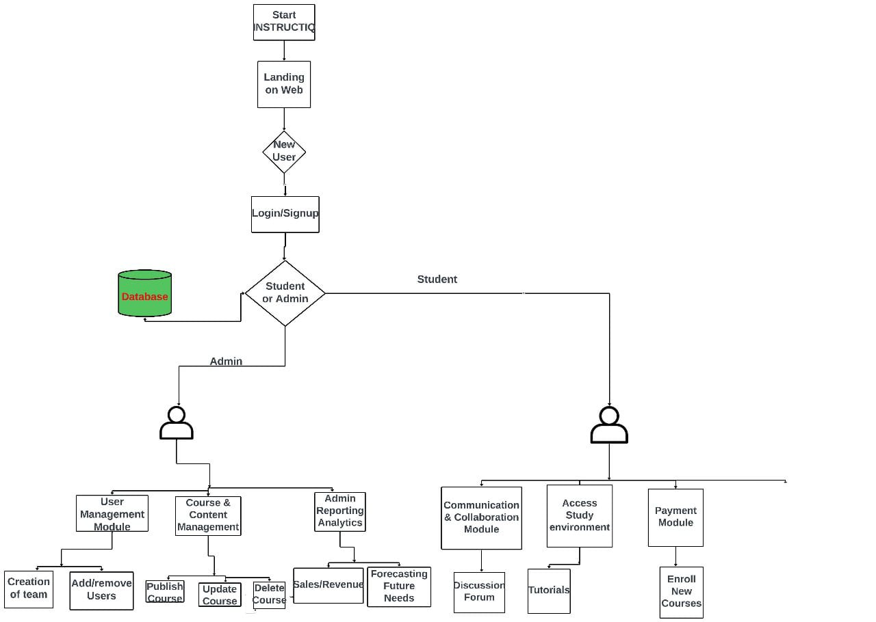
WORK FLOW Diagram
Math with Gestures using AI

Slide 14
PROCESS OF PROJECT
📚 The project aims to create a 'Math Gesture Program' that uses hand gestures to interact with an AI model to solve mathematical problems.
🤲 The concept involves detecting hand gestures and using them to initiate actions, such as drawing a mathematical problem for the AI to solve.
🔍 The video demonstrates using 'CV Zone' for hand detection and 'Google Gemini' as the AI model to interpret the drawings and provide solutions.
💻 The development process is broken down into parts: hand detection, drawing, sending data to the AI model, and creating an interactive app.
🖌For the drawing aspect, the script explains creating a canvas to overlay on the webcam feed and drawing lines based on hand movements.

Slide 15
APPLICATION DESIGN
DIAGRAMS ARE FOLLOWS :
DATA FLOW DIAGRAM
SEQUENCE DIAGRAM

Slide 16
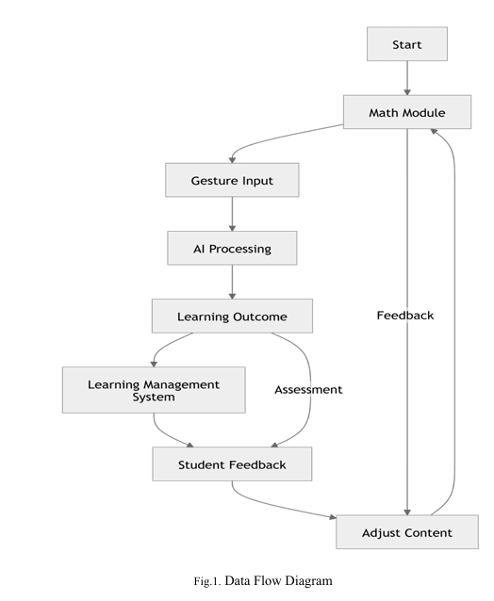

Slide 17
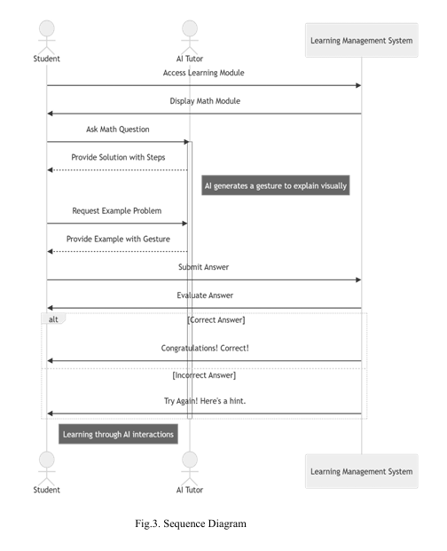

Slide 18
ADVANTAGES
Real-Time Assistance: Users receive instant feedback based on their gestures, allowing them to correct mistakes in real-time and progressively improve their mathematical understanding.
Easy to Understand: Using gestures to learn math makes it feel natural. It helps students understand tricky ideas by physically interacting with them, making it easier to remember.
Custom Learning: The system adjusts to each student’s speed and style of learning. It suggests solutions and exercises that fit their specific needs, making learning more effective.
No Language Barriers: Since gestures don’t rely on words, students from different language backgrounds can use the system easily. This makes it inclusive for everyone.

Slide 19
LIMITATIONS
Accuracy Problems:
Gesture Errors: The system might misunderstand gestures if the hand movements aren’t clear, the lighting is bad, or the background is messy.
Math Errors: The AI might misread drawn numbers or symbols, especially if they’re written in a complicated or unusual way.
Learning Challenges:
Learning Gestures: Users need to learn specific hand movements, which might be hard for those who aren’t comfortable with technology.
Different Styles: People might perform gestures differently, and the system could struggle to understand these variations.
Physical Strain:
Tired Hands: Using hand gestures for a long time, especially for hard math problems, could make users’ hands tired or uncomfortable.
Cost and Maintenance:
Expensive to Build: Making and maintaining an accurate and responsive gesture-based AI system takes a lot of time and money.

Slide 20
FUTURE SCOPE
The future of learning systems, like online platforms (LMS), combined with gesture-based technology and artificial intelligence (AI), could completely change how we learn. Here's the idea in simple terms:
Gesture-Based Learning: Imagine learning math by moving your hands or fingers in the air to draw shapes, solve equations, or rotate 3D objects. It would feel more natural, almost like playing with the math concepts.
AI Assistance: AI would "watch" your gestures, understand what you're doing, and help you in real time. For example, if you're stuck, it could guide you or adjust the lesson to fit your level of understanding.
Interactive and Fun: This approach would make learning math more hands-on and engaging, helping students better understand abstract ideas, like geometry or algebra.In short, combining AI with gesture-based tools could make math learning easier, more interactive, and personalized to each student’s needs..

Slide 21
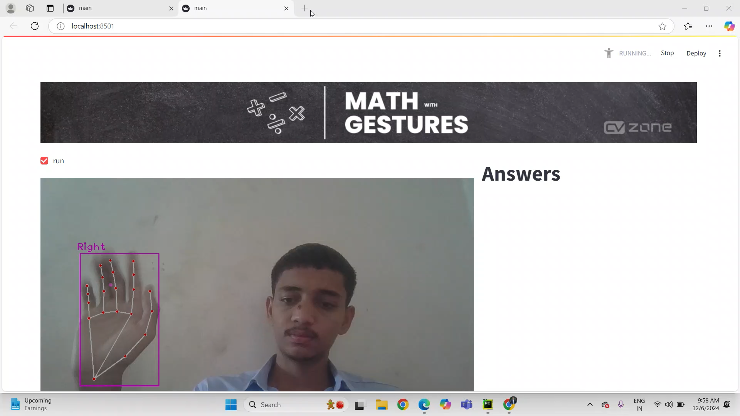
Implementation

Slide 22
REFERENCES
Abhishek B1, Kanya Krishi2, Meghana M3, Hand gesture recognition using machine learning algorithms ISSN: 2722-3221, DOI: 10.11591/ ISSN: 4576-7854
Mohammed Daaniyaal4, Anupama H . International Journal of Creative Research Thought 2020 IJCRT | Volume 8, Issue 6 June 2020 | ISSN: 2320-2882
Nor Azura Adzharuddin and Lee Hwei Ling, International Journal of e-Education e- Business e-Management and e-Learning · January 2013 DOI: 10.7763/IJEEEE.2013.V3.233
https://www.researchgate.net/figure/Learning-Management-System
https://www.computervision.zone/courses/maths-with-gestures-using-ai
https://www.researchgate.net/publication/261071937_Learning_Math_Using_Gesture

Slide 23
THANK YOU

